Slide 1

INTRODUCTION TO PYTHON FOR DATA SCIENCE
Margaret Oluwadare

Slide 2
Table of content
Introduction
Introduction to Data analytics/science
Introduction to Python as a programming language
Why Python
Key challenges faced by Data scientist
Importance of essential keys and tools
Python programming
Data manipulation and analysis
Statistics and machine learning
Rewards of Being a Data Scientist
Essential Skills and Tools for Data Scientists
Getting Started with Python
Why Python is popular in data science
Python Features and Libraries
Overview of Python features
Key libraries: NumPy, Pandas, SciKit-learn
Introduction to Python
Why Python in Data Science
Python Features and Libraries
Key Libraries
Basic syntax and structure

Slide 3
INTRODUCTION
Data Science and Analytics with Python aims to equip you with the knowledge and skills needed to tackle data science problems using Python.
Covers fundamental concepts, essential tools, and practical applications in data science.
Data science involves extracting insights and knowledge from structured and unstructured data.
It combines various disciplines such as statistics, computer science, and domain knowledge to solve complex problems
Importance of Data Science
Data science is transforming industries by providing insights and guiding decision-making processes.
It leverages data to identify patterns, make predictions, and optimize operations.
Why Python?
Python is a versatile, high-level programming language widely used in data science.
It has a robust ecosystem of libraries and tools, making it ideal for data manipulation, analysis, and visualization.
Python's readability and simplicity make it accessible for beginners and powerful for experts.

Slide 4
Key challenges faced by data scientist
Data Quality and Management: Ensuring data accuracy, completeness, and consistency.
Data Privacy and Security: Protecting sensitive information and complying with regulations.
Interdisciplinary Skills: Balancing technical skills with domain expertise and effective communication.
Importance of Essential Skills and Tools
Programming: Proficiency in languages like Python for data manipulation and analysis.
Statistical Analysis: Understanding and applying statistical methods to interpret data.
Machine Learning: Developing models to make predictions and automate decision-making.
Data Visualization: Communicating findings through clear and effective visual representations.

Slide 5
Rewards of Being a Data Scientist
Career Opportunities
Data scientists are in high demand across various industries such as finance, healthcare, technology, and retail.
Opportunities for career growth and advancement are abundant due to the increasing reliance on data-driven decision-making.
Impact on Various Industries
Data scientists contribute to significant advancements in fields such as artificial intelligence, healthcare analytics, and financial modeling.
Their work helps organizations improve efficiency, reduce costs, and innovate new products and services.
Continuous Learning and Growth
The field of data science is constantly evolving with new technologies, methodologies, and tools.
Data scientists have the opportunity to continuously learn and expand their skillsets, staying at the forefront of technological advancements.

Slide 6
Essential Skills and Tools for Data Scientists Python programming

Slide 7
Python Programming
Essential for data manipulation, analysis, and automation.
Python's simplicity and extensive libraries make it a preferred choice for data scientists.
Data Manipulation and Analysis
Proficiency in libraries like Pandas for data manipulation.
Experience with tools such as SQL for database management and querying.
Statistical Analysis
Strong foundation in statistics to understand data distributions and relationships.
Application of statistical methods for hypothesis testing and inference.
Machine Learning
Knowledge of machine learning algorithms and their applications.
Use of libraries like SciKit-learn for building and evaluating models.
Data Visualization
Ability to create clear and insightful visual representations of data.
Use of libraries such as Matplotlib and Seaborn for plotting and visualization.

Slide 8
Introduction to Python as a programming language

Slide 9
Introduction to Python
Python is a high-level, versatile programming language.
Known for its simplicity, readability, and extensive support libraries.
Widely used in data science for its powerful data manipulation and analysis capabilities.
Why Python is Popular in Data Science
Extensive libraries and frameworks.
Supportive community and abundant resources.
Versatility in various stages of data science workflow: data collection, cleaning, analysis, and visualization.
Python Features and Libraries
Easy-to-read syntax.
Dynamic typing and memory management.
Interpreted language allowing for interactive coding.

Slide 10
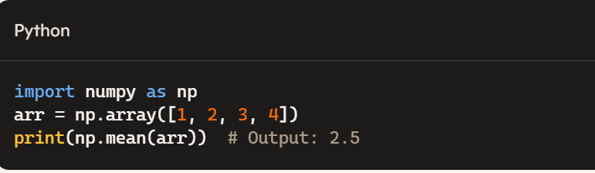
Key Libraries
NumPy: Provides support for large, multi-dimensional arrays and matrices, along with a collection of mathematical functions. Example Using NumPy for array manipulations:
CLASS WORK
Create a 1D array with values ranging from 0 to 9.
HOMEWORK
Convert a 1D array to a 2D array with 2 rows
2. Extract all odd numbers from an array of 1-10

Slide 11
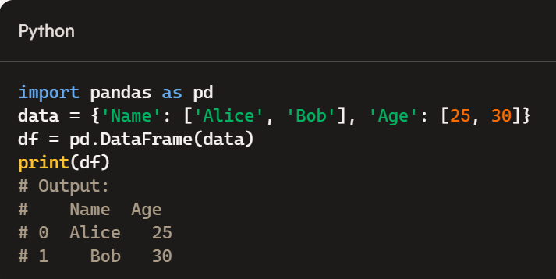
PANDAS
Offers data structures and data analysis tools. Example of Using Pandas to manipulate data frames:
CLASS WORK
Write a Pandas program to create and display a one-dimensional array-like object containing an array of data using Pandas module.
HOMEWORK
1. Write a Pandas program to convert a Panda module Series to Python list and it's type.
2. Write a Pandas program to add, subtract, multiple and divide two Pandas Series. Sample Series: [2, 4, 6, 8, 10], [1, 3, 5, 7, 9]

Slide 12
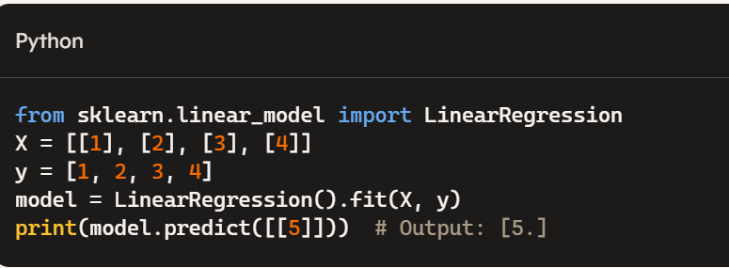
SCIKIT-LEARN
Provides simple and efficient tools for data mining and data analysis, particularly in machine learning. Example Using SciKit-learn for a basic machine learning model:
CLASS WORK

Slide 13
ESSENTIALS OF DATA ANALYTICS USING PANDAS

Slide 14
INTRODUCTION
Pandas is a software library written for the Python programming language for data manipulation and analysis.
It provides fast, flexible, and expressive data structures designed to make working with “relational” or “labeled” data easy and intuitive.
Pandas in Python is built on top of NumPy and is intended to integrate well within a scientific computing environment with many other 3rd party libraries.
There are two primary data structures of pandas: Series (1-dimensional) and Data frame (2-dimensional)
PANDA DATAFRAME
The Pandas Data Frame is a structure that contains two-dimensional data and its corresponding labels (headers)
It is similar to SQL tables or the spreadsheets that you work within Excel or Calc.

Slide 15
PANDAS USE CASE
Easy handling of missing data (represented as NaN) in floating point as well as non-floating point data
Size mutability
Intelligent label-based slicing, fancy indexing, and subsetting of large data sets
Flexible reshaping and pivoting of data sets
Robust IO tools for loading data from flat files (CSV and delimited), Excel files, databases, and saving/loading data from the ultrafast HDF5 format
Time series data
Tabular data with heterogeneously-typed columns, as in an SQL table or Excel spreadsheet
Arbitrary matrix data (homogeneously typed or heterogeneous) with row and column labels
Any other form of observational/statistical data sets. The data need not be labeled at all to be placed into a pandas data structure

Slide 16
Step-By-Step Guide To Data Analysis With Pandas In Python
view the first 8 lowest ticket prices (fare column).
df.sort_values("Fare").head(8)
1. Install the package: !pip install pandas
2. Import pandas package: import pandas as pd ( note that there is a dot after “pd” which is used to call a method from Pandas library.)
3. import dataset: Using the syntax read_csv(“filepath”)
4. To view the contents of the dataset we are going to use the df.head(), df.tail(). Note: if the () is left blank then the first 5 elements of the table will be displayed. You want a specific number of entries, then you can give the command as df.head(n) to print the first n rows.
5. Now if you want to read some specific columns only from the dataset, you can use the usecols argument to specify the column names that we want to work with. Let’s work with just PassengerId, Survived, Pclass columns.
6. Run the describe() command to get a summary of numeric values in your dataset
7. Sort Columns based on specific criteria. As an example, we will sort columns based on numeric data, string, etc. Let view the first 8 lowest ticket prices (fare column).
df.sort_values("Fare").head(8)

Slide 17
8. To view the highest-paying passengers, df.sort_values("Fare", ascending = False).head(8)
9. Count the occurrences of variables using value_counts() to count the occurences of each variable in a column.
10. Data Filtering: Perform data filtering based on your analytical need. For example to display those passengers who are female and their fare is less than 100.
df_fare_mask = df["Fare"] < 100
df_sex_mask = df["Sex"] == "female"
df[df_fare_mask & df_sex_mask]
11. Null values (NaN): One of the most common problems in data science is missing values. To detect them, there is a beautiful method which is called isnull(). With this method, we can get a boolean series (True or False). For example to show the passengers whose cabin is unknown (NaN).
null_mask = df["Cabin"].isnull()
df[null_mask]

Slide 18
OTHER PANDA FUNCTIONS
Data Info: Check the data types and non-null counts. df.info()
Drop missing rows: df.dropna()
Fill missing values : df['column_name'].fillna(value)
Remove duplicates: df.drop_duplicates()
Grouping data: df.groupby('column_name').sum()
Reference: See here

Slide 19
WEEK 1 PROJECT
Access the IRIS DATASET and perform the following task:
Descriptive Analysis
1. What are the basic statistics (mean, median, standard deviation, min, max, etc.) for each feature in the Iris dataset?
2. How do the feature distributions (sepal length, sepal width, petal length, petal width) look? Can we visualize them using histograms?
3. What is the distribution of the different species in the dataset? How do we visualize this distribution?

Slide 20
Correlation and Relationships
4. What is the correlation between different features in the dataset? Can we create a correlation matrix?
5. Is there a specific pair of features that shows the strongest correlation?
6. How do the features compare among different species? Can we visualize this using box plots?
Hypothesis Testing
7. Is there a statistically significant difference in sepal length among the different species?
8. Can we perform a t-test to compare the means of two species for petal width?
Visualization
9. Can we create a scatter plot matrix to visualize the relationships between all features?
10. How can we visualize the decision boundaries for the classification of the species using a pair of features?

Slide 21
Data Cleaning and Preparation
11. Are there any missing values in the dataset? If so, how can we handle them using Pandas?
12. Are there any outliers present in the dataset? If so, how can we identify and manage them?
Advanced Analysis
13. Can we use Pandas to create a new feature based on existing features (e.g., aspect ratio of the petals)?
14. How can we group the data by species and calculate the average values for each feature?
Classification and Predictions
15. Can we split the dataset into training and testing sets using Pandas? How can we prepare it for machine learning?
16. How can we analyze the feature importance if we decide to use a model like Random Forest for classification?
Time Series Analysis
17. If we had a time component to the dataset, how would we use Pandas to analyze trends over time?

